Slide 1
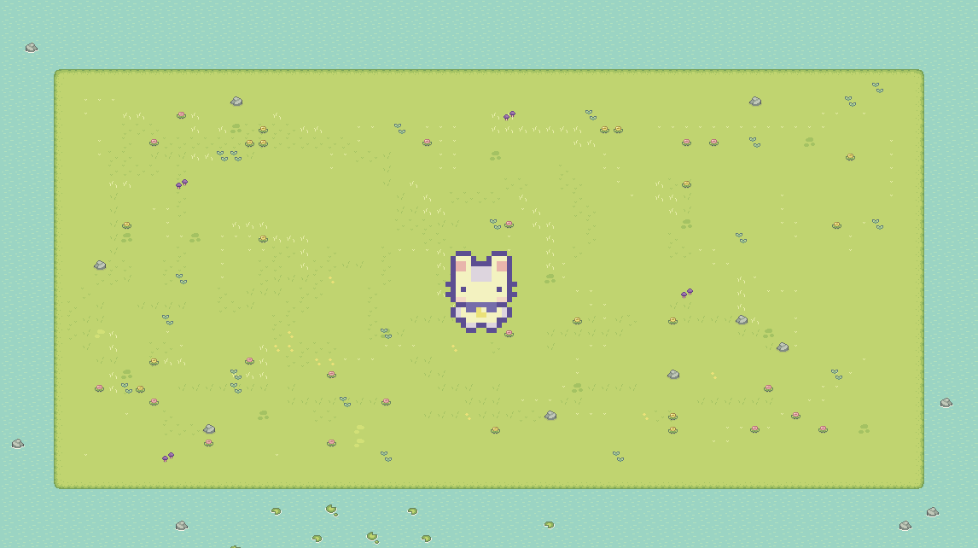
ASL FARM
Created By
Jakob Cox - Tanjai Ploykao - Yeabtsega Tena

Slide 2
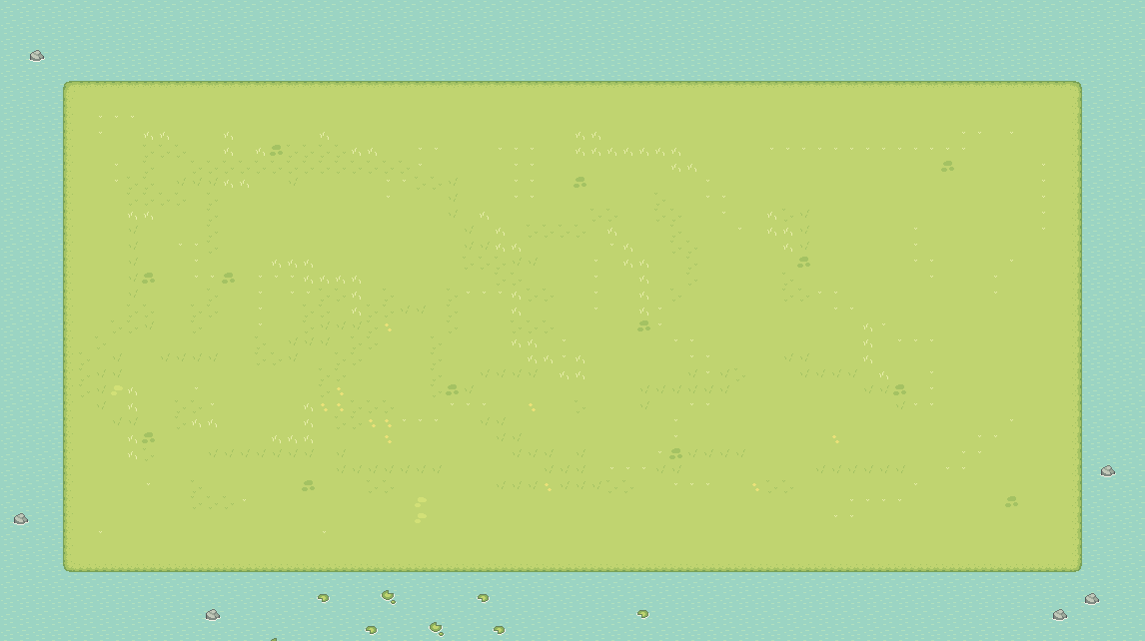
What is ASL Farm?
ASL Farm is an educational game that teaches the player American sign language(ASL) while they try to grow the trees on their farm as large as possible.

Slide 3
Why ASL Farm?
The initial prompt we decided on, was to create a game that uses hand gestures to play.
After some discussion it was decided to make a game that helps you learn hand gestures while playing.

Slide 4
The Goal
To be used as an introduction to learn ASL.
Teach the player common ASL signs
Test the players knowledge and show progress through tree growth.

Slide 5
Sounds
ASL Farm, initially was going to have no sound.
People who are deaf can sometimes still hear melodies and low decibel sounds.
Lofi with a focus on bass and melody.
We wanted to give credit to artists, so we included a window that displays the current song and the song’s artist.

Slide 6
The Art
The ASL Signs for the game were created by Tanjai
The background, character, and home assets came from a free asset pack created call Sprout Lands – created by Cup Nooble
The Tree assets were created by Admurin

Slide 7
How to play
The player starts in their home.
They are able to learn new ASL Signs by reading the news paper.
They then must tend to their farm and head outside to test their knowledge by tending to their trees.
When done tending to the trees its time to sleep, so the player heads back inside to their bed.

Slide 8
The Software
We decided on Godot as the game engine we would use for the project.
It is free to download
It is easier for beginners to learn
It has many tools to develop 2D games
It has exporting tools built in.

Slide 9
Essential Scenes and Scripts
Game Manager – Runs the game.
Farm Scene – Used to initiate quizzes and show progress
Home Scene – Used to introduce new Signs and reset the day.
Data Manager – A global script that contains the game data.
Sounds – A global script that plays all music and sound effects
Main Menu – The scene the player initially sees when the game is started

Slide 10
